Slide 1


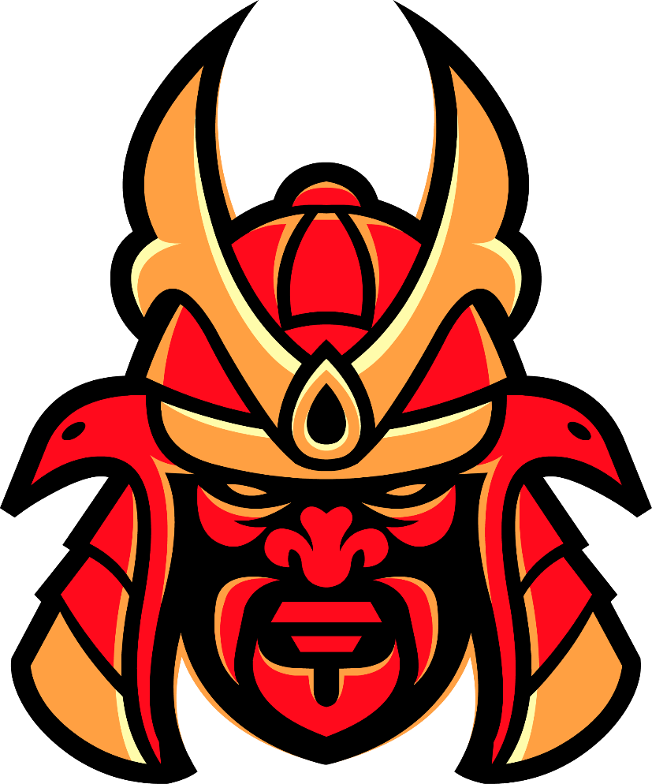

Slide 2



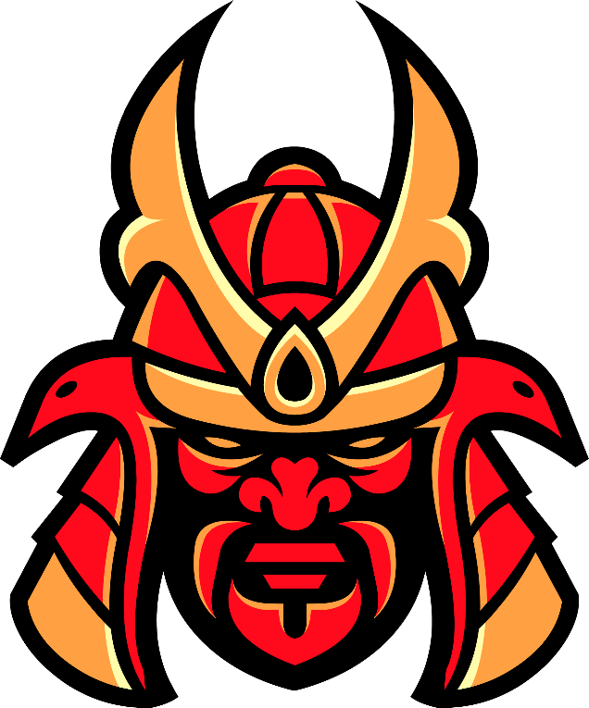
Our logo has been invented
in January 2021,
We have made our company logo
through 99designs.
ACryptoS offers 2 products on Binance
Smart Chain, yield optimizer ACryptoS
Vaults and stablecoin DEX ACryptoS
StableSwap.
Our tokenomics and fees
are designed to encourage longer term
staking, and reward long term holders
of our ACS and ACSI native tokens.

Slide 3

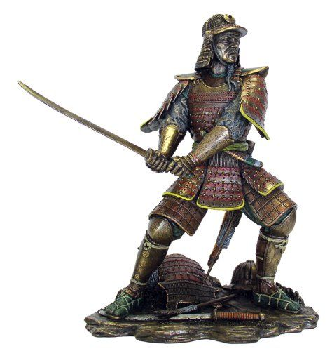
We adopted the Japanese Samurai’s
Head as our logo
The samurai is an important symbol
in Japanese culture. Their Bushido
code, aka “the way of the warrior,”
made them role models for discipline,
respect, and ethical behaviour in Japan.
These warriors shaped the country through both warfare and their conduct
We have a mission like samurai in
our company !!!

Slide 4

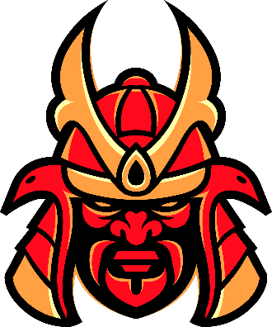
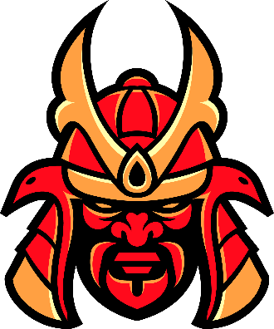

Slide 5

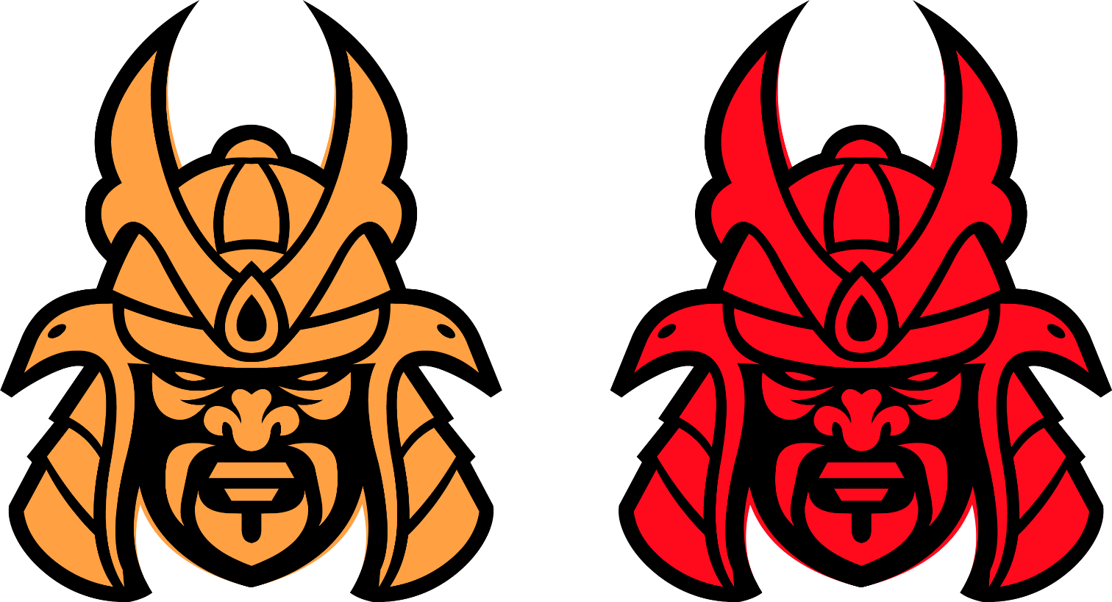

Slide 6

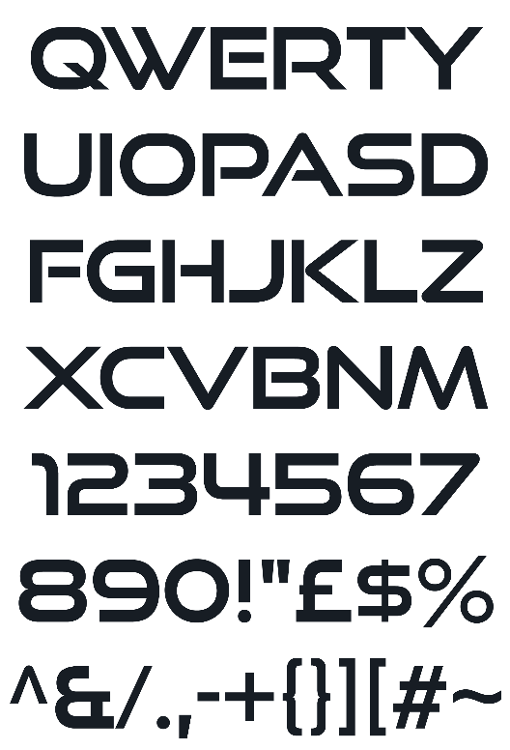
Logo font’s name:
Good Times
The font is available free
of charge.
The original font style is just
regular and capitalize only,
We have used
it in original as well,
but in Bold option.
Download link:
https://www.dafont.com/good-times.font

Slide 7


Dark Brown
Dark Red
Solid Red
R: 0 G: 0 B: 0
HEX: #000000
C: 75 M: 68 Y: 67 K: 90
R: 163 G: 7 B: 20
HEX: #A30714
C: 24 M: 100 Y: 100 K: 20
R: 235 G: 10 B: 28
HEX: #EB0A1C
C: 1 M: 100 Y: 100 K: 0
Brown
Gold Brown
Light Gold
R: 175 G: 81 B: 47
HEX: # AF512F
C: 23 M: 78 Y: 92 K: 13
R: 233 G: 160 B: 67
HEX: #E9A043
C: 7 M: 41 Y: 85 K: 0
R: 230 G: 228 B:153
HEX: #E6E499
C: 11 M: 3 Y: 60 K: 0

Slide 8
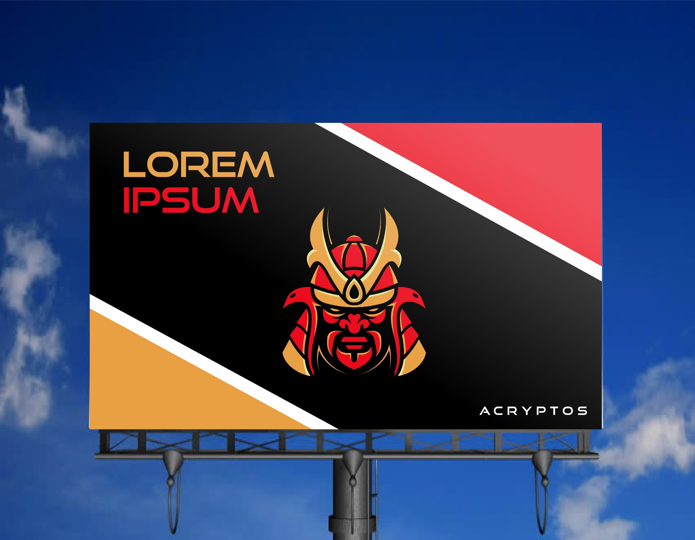

Slide 9
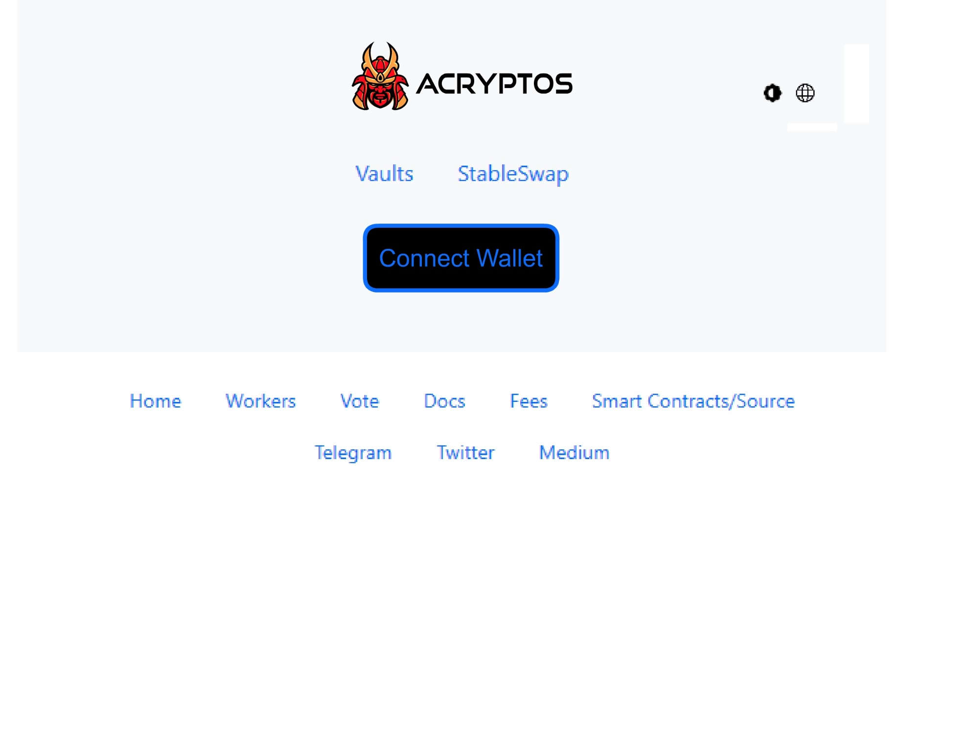


Slide 10
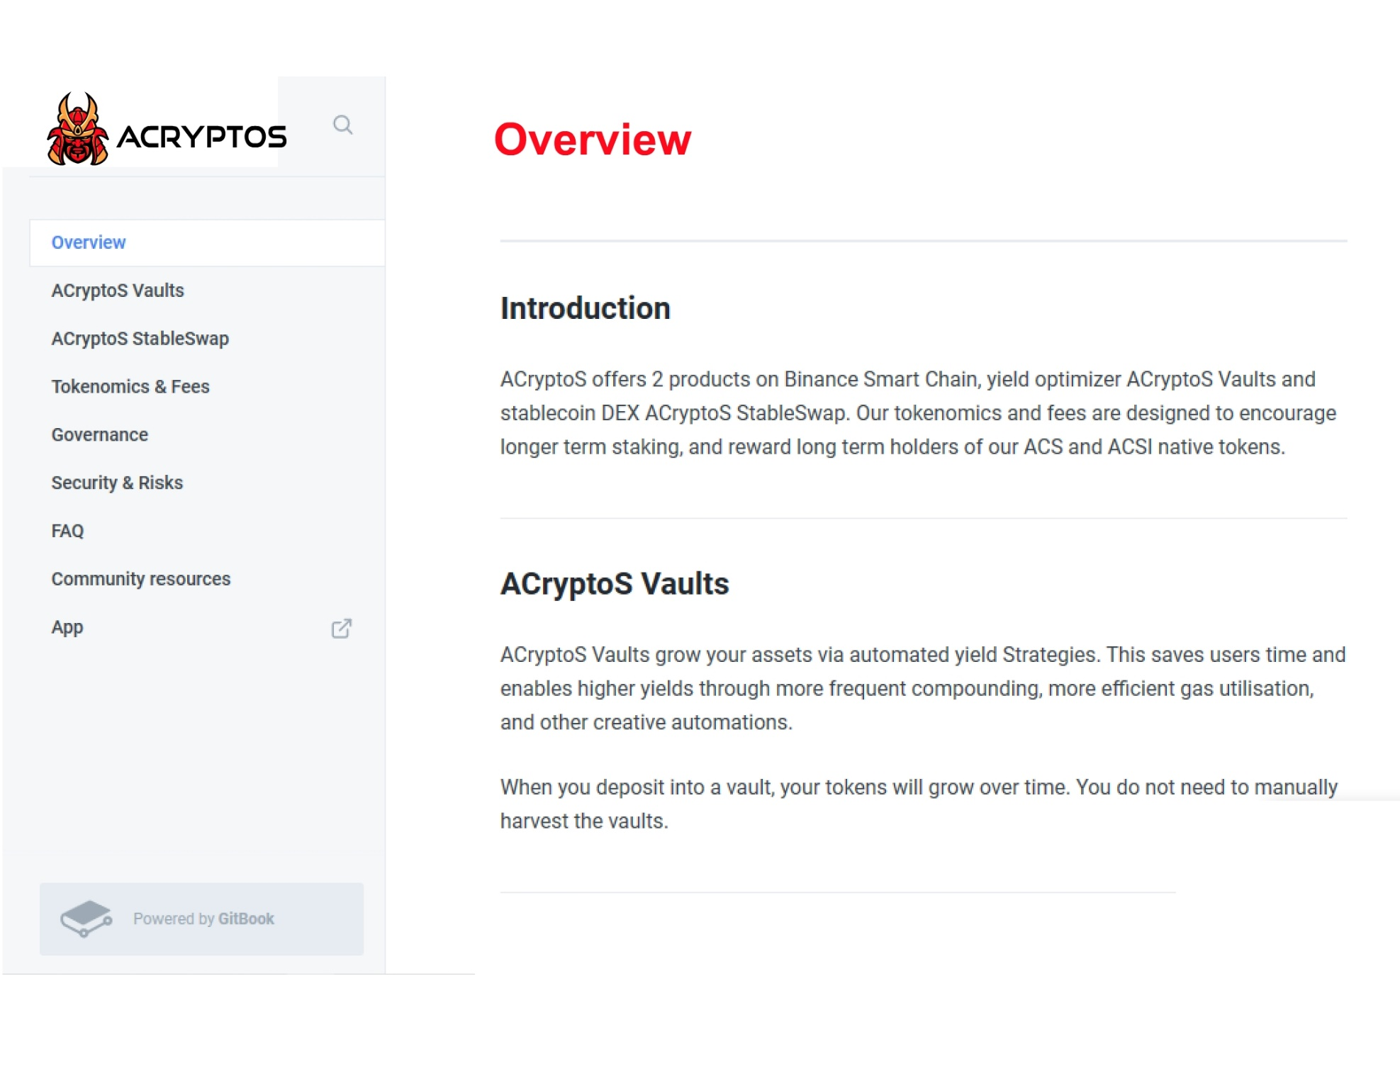

Slide 11

https://app.acryptos.com/

Slide 12


